Slide 1
N. Rizk
COSC 3337 : Data Science I
College of Natural and Applied Sciences
Department of Computer Science
University of Houston

Slide 2
What is Cluster Analysis?
Cluster: a collection of data objects
  Similar to one another within the same cluster
  Dissimilar to the objects in other clusters
Cluster analysis
  Finding similarities between data according to the characteristics found in the data and grouping similar data objects into clusters
Unsupervised learning: no predefined classes
Typical applications
  As a stand-alone tool to get insight into data distribution
  As a preprocessing step for other algorithms

Slide 3
Measure the Quality of Clustering
Dissimilarity/Similarity metric: Similarity is expressed in terms of a distance function, which is typically metric: d(i, j)
There is a separate “quality” function that measures the “goodness” of a cluster.
The definitions of distance functions are usually very different for interval-scaled, boolean, categorical, ordinal and ratio variables.
Weights should be associated with different variables based on applications and data semantics.
It is hard to define “similar enough” or “good enough”
  the answer is typically highly subjective.

Slide 4
Intra-cluster and Inter-cluster distances
Inter-cluster distances are maximized
Intra-cluster distances are minimized
The quality of a clustering result depends on both the similarity measure used by the method and its implementation.
The quality of a clustering method is also measured by its ability to discover some or all of the hidden patterns

Slide 5
What is good clustering?
A good clustering method will produce high quality clusters with
  high intra-class similarity
  low inter-class similarity
The quality of a clustering result depends on
  the similarity measure used
  implementation of the similarity measure
The quality of a clustering method is also measured by its ability to discover some or all of the hidden patterns

Slide 6
Requirements of clustering
Scalability
Ability to deal with different types of attributes
Discovery of clusters with arbitrary shape
Minimal requirements for domain knowledge to determine input parameters
Ability to deal with noise and outliers
Insensitivity to order of input records
High dimensionality
Incorporation of user-specified constraints
Interpretability and usability

Slide 7
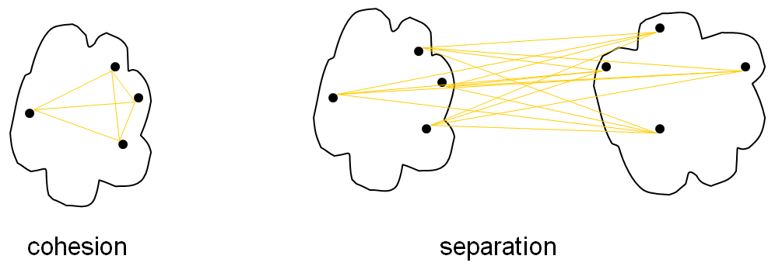
Cohesion and Separation
Cohesion is measured by the within cluster sum of squares(How closely related are objects in a cluster?)
WSS =
∑ ∑
(x − m )
2
i
i x∈C_{i}
Separation is measured by the between cluster sum of squares(How distant and well separated a cluster is from other clusters)
BSS =
∑
C_{i} (m − m_{i} )
2
i
where |Ci| is the size of cluster i, m is the centroid of the whole data set
BSS + WSS = constant
WSS (Cohesion) measure is called Sum of Squared Error (SSE)—a commonly used measure
A larger number of clusters tend to result in smaller SSE
FINAL EXAM CALCULATION
‹#›

Slide 8
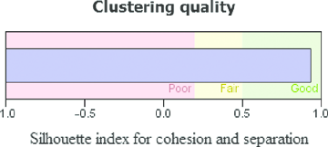
Silhouette Coefficient
Silhouette Coefficient combines ideas of both cohesion and separation
For an individual point, i
  Calculate a = average distance of i to the points in its cluster( Smaller the value better the assignment)
  Calculate b = min (average distance of i to points in another cluster)
  The silhouette coefficient for a point is then given by
s = 1 – a/b if a < b,
(s = b/a - 1 if a ≥ b, not the usual case)
Typically between 0 and 1
The closer to 1 the better
b
a
‹#›

Slide 9
Silhouette Coefficient…continue
S.A. is a way to measure how close each point in a cluster is to the points in its neighboring clusters
Its a neat way to find out the optimum value for k during k-means clustering.
Silhouette values lies in the range of [-1, 1]. A value of +1 indicates that the sample is far away from its neighboring cluster and very close to the cluster its assigned. Similarly, value of -1 indicates that the point is close to its neighboring cluster than to the cluster its assigned. And, a value of 0 means its at the boundary of the distance between the two cluster. Value of +1 is idea and -1 is least preferred.

Slide 10
Correlation with Distance Matrix
Distance Matrix
  D_{ij} is the similarity between object O_{i} and O_{j}
Incidence Matrix
  C_{ij}=1 if O_{i} and O_{j} belong to the same cluster, C_{ij}=0 otherwise
Compute the correlation between the two
matrices
  Only n(n-1)/2 entries needs to be calculated
High correlation indicates good clustering
‹#›

Slide 11
Correlation with Distance Matrix
Given Distance Matrix D = {d₁₁,d₁₂, …, d_{nn} } and Incidence Matrix C= { c₁₁, c₁₂,…, c_{nn} } .
Correlation r between D and C is given by
∑(d_{ij} − d )(c_{ij} − c)
i=1, j =1
n
_ _
r =
∑(d
i=1, j =1
n
_
− d )²
n
_
(c− c)
∑ ij
2
ij
i=1, j =1
‹#›

Slide 12
Are There Clusters in the Data?
1
1
0.9
0.9
0.8
0.8
Random Points
0.7
0.7
DBSCAN
0.6
0.6
y
0.5
y
0.5
0.4
0.4
0.3
0.3
0.2
0.2
0.1
0.1
0
0
0.2
0.4
0.6
0.8
1
0
0
0.2
0.4
0.6
0.8
1
How to do Distance Matrix?
x
x
1
1
0.9
0.9
K-means
0.8
0.8
Complete Link
0.7
0.7
0.6
0.6
y
0.5
y
0.5
0.4
0.4
0.3
0.3
0.2
0.2
0.1
0.1
0
0
0.2
0.4
0.6
0.8
1
0
0
0.2
0.4
0.6
0.8
1
x
x
‹#›

Slide 13

Measuring Cluster Validity Via Correlation
Correlation of incidence and distance matrices for the K- means clustering of the following two data sets
Representative of cluster -> Incident Matrix
1
1
0.9
0.9
0.8
0.8
0.7
0.7
0.6
0.6
y
0.5
y
0.5
0.4
0.4
0.3
0.3
0.2
0.2
0.1
0.1
0
0
0.2
0.4
0.6
0.8
1
0
0
0.2
0.4
0.6
0.8
1
x
x
Corr = -0.9235
Corr = -0.5810
‹#›

Slide 14
Cluster 1 ={{1,0},{1,1}}
Cluster 2 {{1,2},{2,3},{2,2},{1,2}},
Cluster 3 ={{3,1},{3,3},{2,1}}
Take a point {1,0} in cluster 1
Calculate its average distance to all other points in it’s cluster,
For cluster 1
=√( (1-1)^2 + (0-1)^2) =√(0+1)=√1=1
🡺 the average distance of point {1,0} in cluster 1
to all the points in cluster 1 = 1
for the object {1,0} in cluster 1 calculate its average
distance from all the objects in cluster 2 and cluster 3.
Of these take the minimum average distance.

Slide 15
Cluster 1 ={{1,0},{1,1}}
Cluster 2 {{1,2},{2,3},{2,2},{1,2}},
Cluster 3 ={{3,1},{3,3},{2,1}}
So for cluster 2
{1,0} ----> {1,2} = distance = √((1-1)^2 + (0-2)^2) =√(0+4)=√4=2
{1,0} ----> {2,3} = distance = √((1-2)^2 + (0-3)^2) =√(1+9)=√10=3.16
{1,0} ----> {2,2} = distance = √((1-2)^2 + (0-2)^2) =√(1+4)=√5=2.24
{1,0} ----> {1,2} = distance = √((1-1)^2 + (0-2)^2) =√(0+4)=√4=2
🡺 the average distance of point {1,0} in cluster 1 to all the points in cluster 2 = (2+3.16+2.24+2)/4 = 2.325

Slide 16
Cluster 1 ={{1,0},{1,1}}
Cluster 2 {{1,2},{2,3},{2,2},{1,2}},
Cluster 3 ={{3,1},{3,3},{2,1}}
So for cluster 3
{1,0} ----> {3,1} = distance = √((1-3)^2 + (0-1)^2) =√(4+1)=√5=2.24
{1,0} ----> {3,3} = distance = √((1-3)^2 + (0-3)^2) =√(4+9)=√13=3.61
{1,0} ----> {2,1} = distance = √((1-2)^2 + (0-1)^2) =√(1+1)=√2=2.24
🡺 the average distance of point {1,0} in cluster 1 to all the points in cluster 3 =(2.24+3.61+2.24)/3 = 2.7

Slide 17
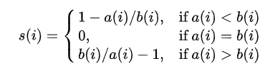
Silhouette coefficient for cluster 1
{1,0} from cluster 1 is 1 (a1)
{1,0} from cluster 2 is 2.325
{1,0} from cluster 3 is 2.7
Since 2.325<2.7🡺 the minimum average is 2.325 (b1)
So the silhouette coefficient of cluster 1
s1= 1-(a1/b1) = 1- (1/2.325)=1-0.4301=0.5699

Slide 18
Silhouette coefficient for cluster 2 and cluster 3
Calculate the silhouette coefficient for cluster 2 and cluster 3 separately by taking any single object point in each of the clusters and repeating the previous steps.
The cluster with the greatest silhouette coefficient is the best as per evaluation.

Slide 19
Cluster 1 ={{1,0},{1,1}}
Cluster 2 {{1,2},{2,3},{2,2},{1,2}},
Cluster 3 ={{3,1},{3,3},{2,1}}
WSS =
∑ ∑
(x − m )
Cohesion(C1) = (1 - 1) ^ 2 + (1 - 1) ^ 2 + (0 - .5) ^ 2 + (1 - .5) ^ 2 = 0.5
(green and brown centroids)
BSS =
∑
C_{i} (m − m_{i} )
Separation: {Between clusters i.e. (C1,C2) , (C1,C3) & (C2,C3)}
Separation(C1,C2) = SSE(Centroid(C1), Centroid(C2))
= (1 - 1.5) ^ 2 + (0.5 - 2.25) ^ 2 = 1 + 3.0625 = 4.0625

Slide 20
The silhouette combines idea of cohesion and separation
Cohesion(C1)=0.5
How dissimilar the points are inside a cluster
🡺small value is preferred
Separation(C1,C2)=4.06 How far C1 to C2
Large value means cluster c1 is badly matched with c2
🡺high value is preferred
Silhouette=0.5699
High separation and low cohesion correponds to values close to 1 for the silhouette
🡺how well the clustering algorithm has performed
🡺can be used to determine the best number of clusters
High Separation, low Cohesion

Slide 21
from sklearn.metrics import silhouette_samples, silhouette_score
# The silhouette_score gives the average value for all the samples.
# This gives a perspective into the density and separation of the formed
# clusters
silhouette_avg = silhouette_score(X, cluster_labels)
print("For n_clusters =", n_clusters,
"The average silhouette_score is :", silhouette_avg)
For n_clusters = 2 The average silhouette_score is : 0.7049787496083262
For n_clusters = 3 The average silhouette_score is : 0.5882004012129721
For n_clusters = 4 The average silhouette_score is : 0.6505186632729437
For n_clusters = 5 The average silhouette_score is : 0.56376469026194
For n_clusters = 6 The average silhouette_score is : 0.4504666294372765

Slide 22

Measuring Clustering Quality
Silhoa _> min(b2,b3)
Cohesion between point and centre of cluster
S= 1-a1/(min(b2,b3))

Slide 23

Measuring Clustering Quality
Two methods: extrinsic vs. intrinsic
Extrinsic: supervised, i.e., the ground truth is available
  Compare a clustering against the ground truth using certain clustering quality measure
  Ex. Purity, precision and recall metrics, normalized mutual information
Intrinsic: unsupervised, i.e., the ground truth is unavailable
  Evaluate the goodness of a clustering by considering how well the clusters are separated, and how compact the clusters are
  Ex. Silhouette coefficient

Slide 24
Entropy and Purity
Notation
– | C_{k} ∩ P_{j} |
the number of objects in both the k-th cluster of
the clustering solution and j-th cluster of the groundtruth
^{| C}_{k} | the number of objects in the k-th cluster of the clustering solution
^{| P}_{j} | the number of objects in the j-th cluster of the groundtruth
Purity
Purity = ¹ ∑max
| C ∩ P |
N
j k
j
k
Normalized Mutual Information
_{I (C, P) = ∑∑}| C_{k} ∩ P_{j} | _{log} N⋅ | C_{k} ∩ P_{j} |
I (C, P)
NMI =
N | C_{k} || P_{j} |
H (C)H (P)
k j
H (C) = ∑^{| Ck |} log ^{| Ck |}
H (P) = ∑^{| Pj |} log ^{| Pj |}
k
N N
N N
j
47

Slide 25
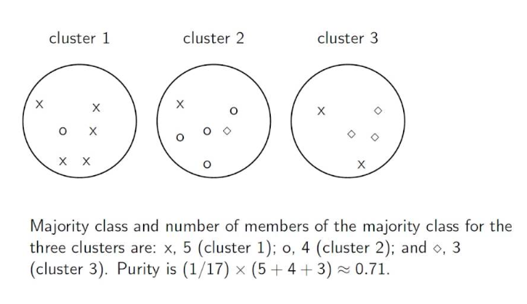
Purity Example

Slide 26

Ground Truth
Each number is an object an each circle or square is a community
Analysis of clustering
{1,3} and {2} maps to 1,2,3 circle
🡺 {2} is wrongly clustered
Thus the use of Normalized Mutual Information NMI to validate a cluster

Slide 27
Normalized Mutual Information
NMI is a good measure for determining the quality of clustering.
It is an external measure because we need the class labels of the instances to determine the NMI.
Since it’s normalized we can measure and compare the NMI between different clustering having different number of clusters.

Slide 28
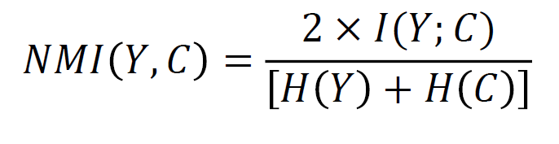
Normalized Mutual Information
Normalized Mutual Information:
where,
Y = class labels
C = cluster labels
H(.) = Entropy
I(Y;C) = Mutual Information b/w Y and C
Note: All logs are base-2.

Slide 29


Calculating NMI for Clustering
Assume m=3 classes and k=2 clusters
Cluster-1 (C=1)
Cluster-2 (C=2)
Class-1 (Y=1)
Class-2 (Y=2)
Class-3 (Y=3)

Slide 30
H(Y) = Entropy of Class Labels
Total
P(Y=1) = 5/20 = ¼
P(Y=2) = 5/20 = ¼
P(Y=3) = 10/20 = ½
1
4
1
4
1
2
H(Y) = − ¹ log
− ¹ log
− ¹ log
= 1.5
4
4
2
This is calculated for the entire dataset and can be calculated prior to clustering, as it will not change depending on the clustering output.

Slide 31
H(C) = Entropy of Cluster Labels
P(C=1) = 10/20 = 1/2
P(C=2) = 10/20 = ½
1
2
H(Y) =− ¹ log
¹ − ¹ log
2 2
= 1
2
This will be calculated every time the clustering changes.

Slide 32

I(Y;C)= Mutual Information
Mutual information is given as:
–
  We already know H(Y)
  H(Y|C) is the entropy of class labels within each cluster, how do we calculate this??
Mutual Information tells us the reduction in the entropy of class labels that we get if we know the cluster labels. (Similar to Information gain in deicison trees)

Slide 33
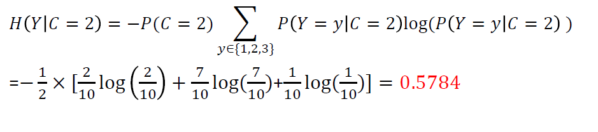
H(Y|C): conditional entropy of class labels for clustering C
Consider Cluster-1:
  P(Y=1|C=1)=3/10 (three triangles in cluster-1)
  P(Y=2|C=1)=3/10 (three rectangles in cluster-1)
  P(Y=3|C=1)=4/10 (four stars in cluster-1)
  Calculate conditional entropy as:
𝐻𝐻 𝑌𝑌 𝐶𝐶 = 1
= −𝑃𝑃(𝐶𝐶 = 1)
�
𝑦𝑦∈{1,2,3}
𝑃𝑃 𝑌𝑌 = 𝑦𝑦 𝐶𝐶 = 1 log(𝑃𝑃 𝑌𝑌 = 𝑦𝑦 𝐶𝐶 = 1 )
1 3
3
10
3
3 4
4
=− ₂ × [ log
+ log( )+ log( )] = 0.7855
10
10
10 10
10

Slide 34
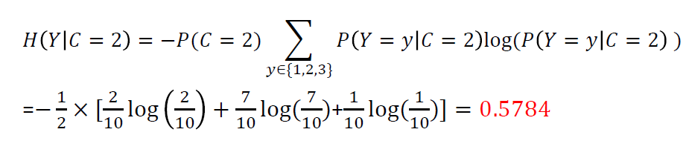
H(Y|C): conditional entropy of class labels for clustering C
Now, consider Cluster-2:
  P(Y=1|C=2)=2/10 (two triangles in cluster-1)
  P(Y=2|C=2)=7/10 (seven rectangles in cluster-1)
  P(Y=3|C=2)=1/10 (one star in cluster-1)
  Calculate conditional entropy as:
𝐻𝐻 𝑌𝑌 𝐶𝐶 = 2
= −𝑃𝑃(𝐶𝐶 = 2)
�
𝑦𝑦∈{1,2,3}
𝑃𝑃 𝑌𝑌 = 𝑦𝑦 𝐶𝐶 = 2 log(𝑃𝑃 𝑌𝑌 = 𝑦𝑦 𝐶𝐶 = 2 )
1 2
2
10
7
7 1
1
=− ₂ × [ log
+ log( )+ log( )] = 0.5784
10
10
10 10
10

Slide 35
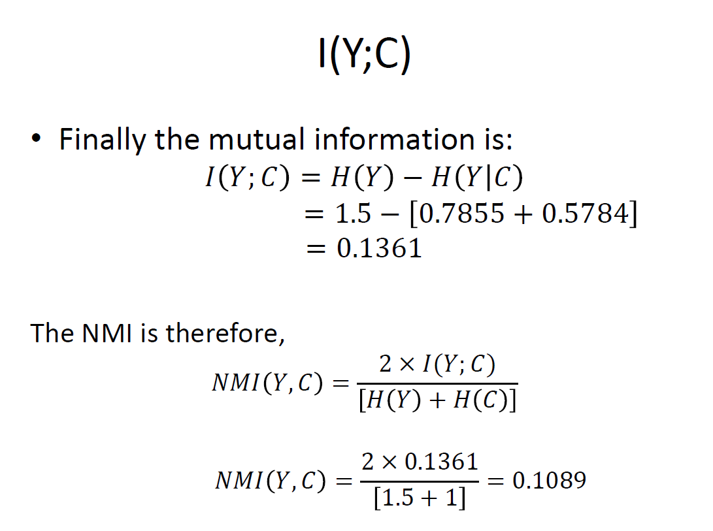

Slide 36
Example
 | P 1 | P 2 | P 3 | P 4 | P5 | P6 | Total
C1 | 3 | 5 | 40 | 506 | 96 | 27 | 677
C 2 | 4 | 7 | 280 | 29 | 39 | 2 | 361
C 3 | 1 | 1 | 1 | 7 | 4 | 671 | 685
C 4 | 10 | 162 | 3 | 119 | 73 | 2 | 369
C 5 | 331 | 22 | 5 | 70 | 13 | 23 | 464
C 6 | 5 | 358 | 12 | 212 | 48 | 13 | 648
total | 354 | 555 | 341 | 943 | 273 | 738 | 3204
Purity = ¹ ∑max
| C ∩ P |
N
j k
j
k
_{Purity =} 506 + 280 + 671+162 + 331+ 358
3204
= 0.7203
_{I (C, P) = ∑∑}| C_{k} ∩ P_{j} | _{log} N⋅ | C_{k} ∩ P_{j} |
_{NMI =} I (C, P)
H (C)H (P)
k j
N | C_{k} || P_{j} |
H (C) = ∑^{| Ck |} log ^{| Ck |}
H (P) = ∑^{| Pj |} log ^{| Pj |}
k
N N
N N
48
j

Slide 37
from sklearn.metrics.cluster import normalized_mutual_info_score normalized_mutual_info_score([0, 0, 1, 1], [0, 0, 1, 1])
Output :1 (perfect labeling)
normalized_mutual_info_score([0, 0, 1, 1], [1, 1, 0, 0])
Output :1 (perfect labeling)
normalized_mutual_info_score([0, 0, 0, 0], [0, 1, 2, 3])
Output :0 (classes members are completely split across different clusters, the assignment is totally in-complete)

Slide 38
Internal Index
“Ground truth” may be unavailable
Use only the data to measure cluster quality
  Measure the “cohesion” and “separation” of clusters
  Calculate the correlation between clustering results and distance matrix
‹#›

Slide 39
Correlation with Distance Matrix
Distance Matrix
  D_{ij} is the similarity between object O_{i} and O_{j}
Incidence Matrix
  C_{ij}=1 if O_{i} and O_{j} belong to the same cluster, C_{ij}=0 otherwise
Compute the correlation between the two
matrices
  Only n(n-1)/2 entries needs to be calculated
High correlation indicates good clustering
‹#›

Slide 40
Correlation with Distance Matrix
Given Distance Matrix D = {d₁₁,d₁₂, …, d_{nn} } and Incidence Matrix C= { c₁₁, c₁₂,…, c_{nn} } .
Correlation r between D and C is given by
∑(d_{ij} − d )(c_{ij} − c)
i=1, j =1
n
_ _
r =
∑(d
i=1, j =1
n
_
− d )²
n
_
(c − c)
∑ ij
2
ij
i=1, j =1
‹#›

Slide 41
Are There Clusters in the Data?
1
1
0.9
0.9
0.8
0.8
Random Points
0.7
0.7
DBSCAN
0.6
0.6
y
0.5
y
0.5
0.4
0.4
0.3
0.3
0.2
0.2
0.1
0.1
0
0
0.2
0.4
0.6
0.8
1
0
0
0.2
0.4
0.6
0.8
1
x
x
1
1
0.9
0.9
K-means
0.8
0.8
Complete Link
0.7
0.7
0.6
0.6
y
0.5
y
0.5
0.4
0.4
0.3
0.3
0.2
0.2
0.1
0.1
0
0
0.2
0.4
0.6
0.8
1
0
0
0.2
0.4
0.6
0.8
1
x
x
‹#›

Slide 42
Measuring Cluster Validity Via Correlation
Correlation of incidence and distance matrices for the K- means clustering of the following two data sets
1
1
0.9
0.9
0.8
0.8
0.7
0.7
0.6
0.6
y
0.5
y
0.5
0.4
0.4
0.3
0.3
0.2
0.2
0.1
0.1
0
0
0.2
0.4
0.6
0.8
1
0
0
0.2
0.4
0.6
0.8
1
x
x
Corr = -0.9235
Corr = -0.5810
‹#›

Slide 43
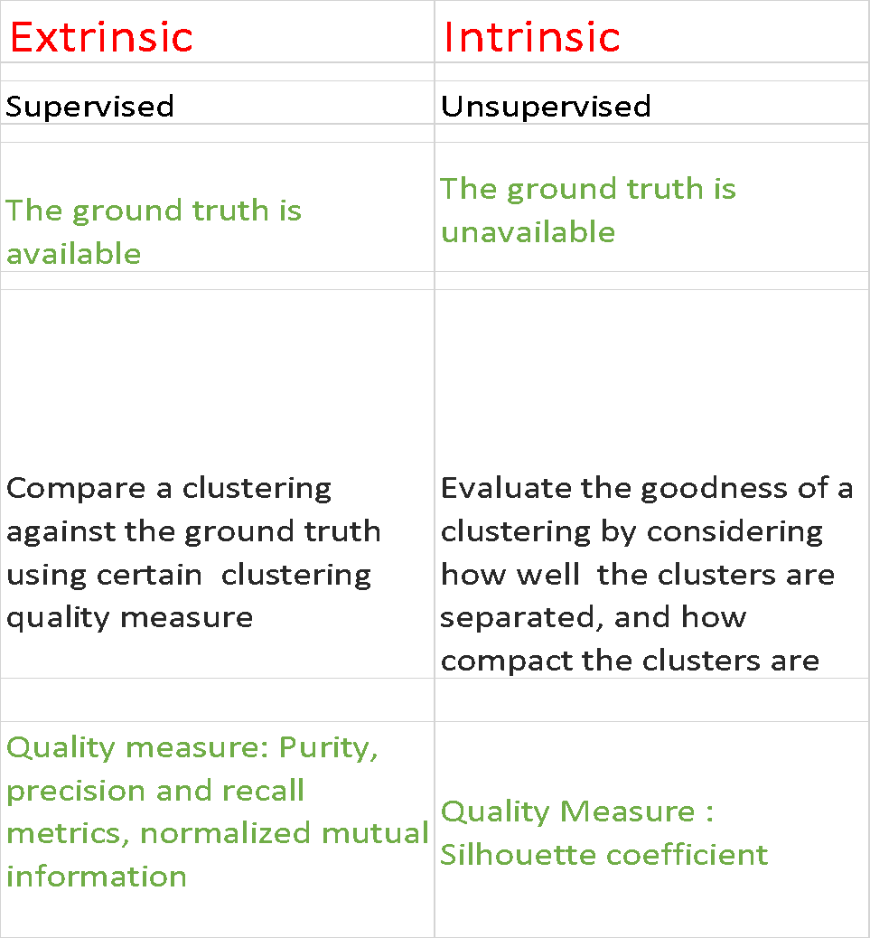
Measuring Clustering Quality

